Slide 3
For nearly 40 years, Daystar University has been providing the finest Christian education for Africans, by Africans. With a current student body exceeding 5,000 and more than 18,000 alumni, thousands of Christian servant leaders are bringing innovation and integrity to their communities.

Slide 4
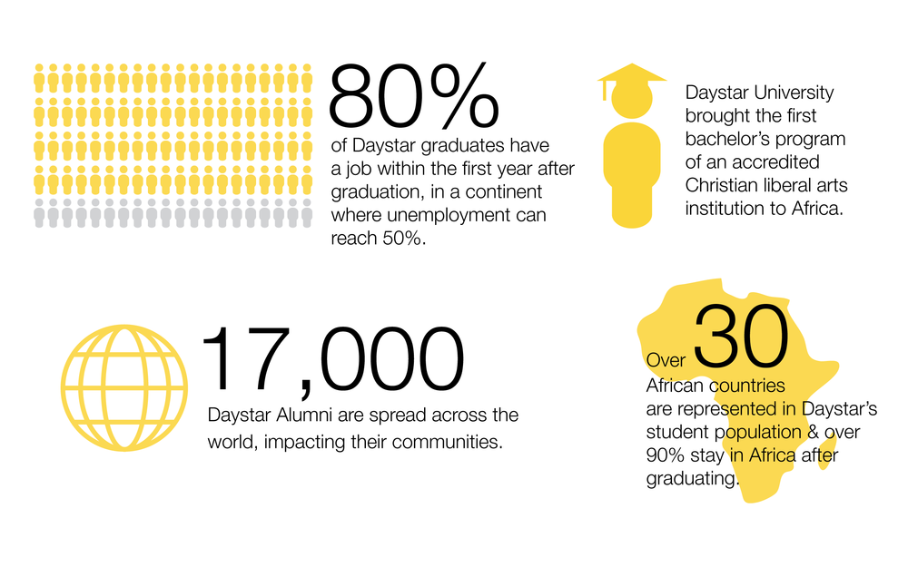

Slide 5
Undergraduate Programs
Bachelor of Arts in Biblical and Religious Studies
Bachelor of Arts in Communication (Public Relations, Electronic Media, Print Media or Advertising).
Bachelor of Arts in Community Development, Integrated
Bachelor of Arts in Community Development, Rural
Bachelor of Arts in English
Bachelor of Arts in French
Bachelor of Arts in Kiswahili
Bachelor of Arts in Literature
Bachelor of Arts in Music
Bachelor of Arts in Peace and Conflict Transformation
Bachelor of Arts in Social Work
Bachelor of Arts in Technical and Professional Communication
Bachelor of Commerce (Accounting, Business Administration ,Marketing, Purchasing and Business Logistics, Law Option, or Management Information Systems)
Bachelor of Education in Business and French
Bachelor of Education in Business and Mathematics
Bachelor of Education in Computer Science and Mathematics
Bachelor of Education in Early Childhood Development : Regular and school based programme
Bachelor of Education in English (Language & Literature)
Bachelor of Education in Music
Bachelor of Education in French
Bachelor of Education in Mathematics
Bachelor of Education in Religious Studies
Bachelor of Education in Religious Studies and Music
Bachelor of Science in Applied Computer Science
Bachelor of Science in Environmental Health
Bachelor of Science in Mathematics
Bachelor of Science in Economics
Bachelor of Science in Nursing
Bachelor of Science in Physics
Bachelor of Theology (B.Th.)
Postgraduate Programs
Master of Arts in Child Development
Master of Arts in Christian Ministries
Master of Arts in Communication (Media Studies, Corporate Communication, or Development Communication)
Master of Arts in Counseling Psychology
Master of Business Administration (MBA) (Strategic Management, Human Resources Management, Finance or Marketing).
Master of Theology in African Christianity (day classes)
PhD in Communication
Postgraduate Diploma in Child Development
Postgraduate Diploma in Education (PGDE) offered during April, August and December school holidays.

Slide 6
Nairobi Campus
Daystar University was first housed at the Nairobi Campus. This campus is located approximately two kilometres from the City Center, at the corner of Ngong Road and Valley Roads. It is a few minutes’ walk from Hurlingham shopping Center, the Kenyatta National Hospital and Nairobi Hospital. It also neighbours Nairobi Baptist Church and is easily accessible by public and private means.
The campus hosts the diploma programmes, day and evening undergraduate programmes, Master’s programmes in Communication, Counseling Psychology, Theology, Economics, Monitoring and Evaluation, Child Development and Business, and PhD in Communication and Clinical Psychology.
At this campus, the university also offers short courses in various areas including communication, community development, business and Christian ministries.

Slide 7
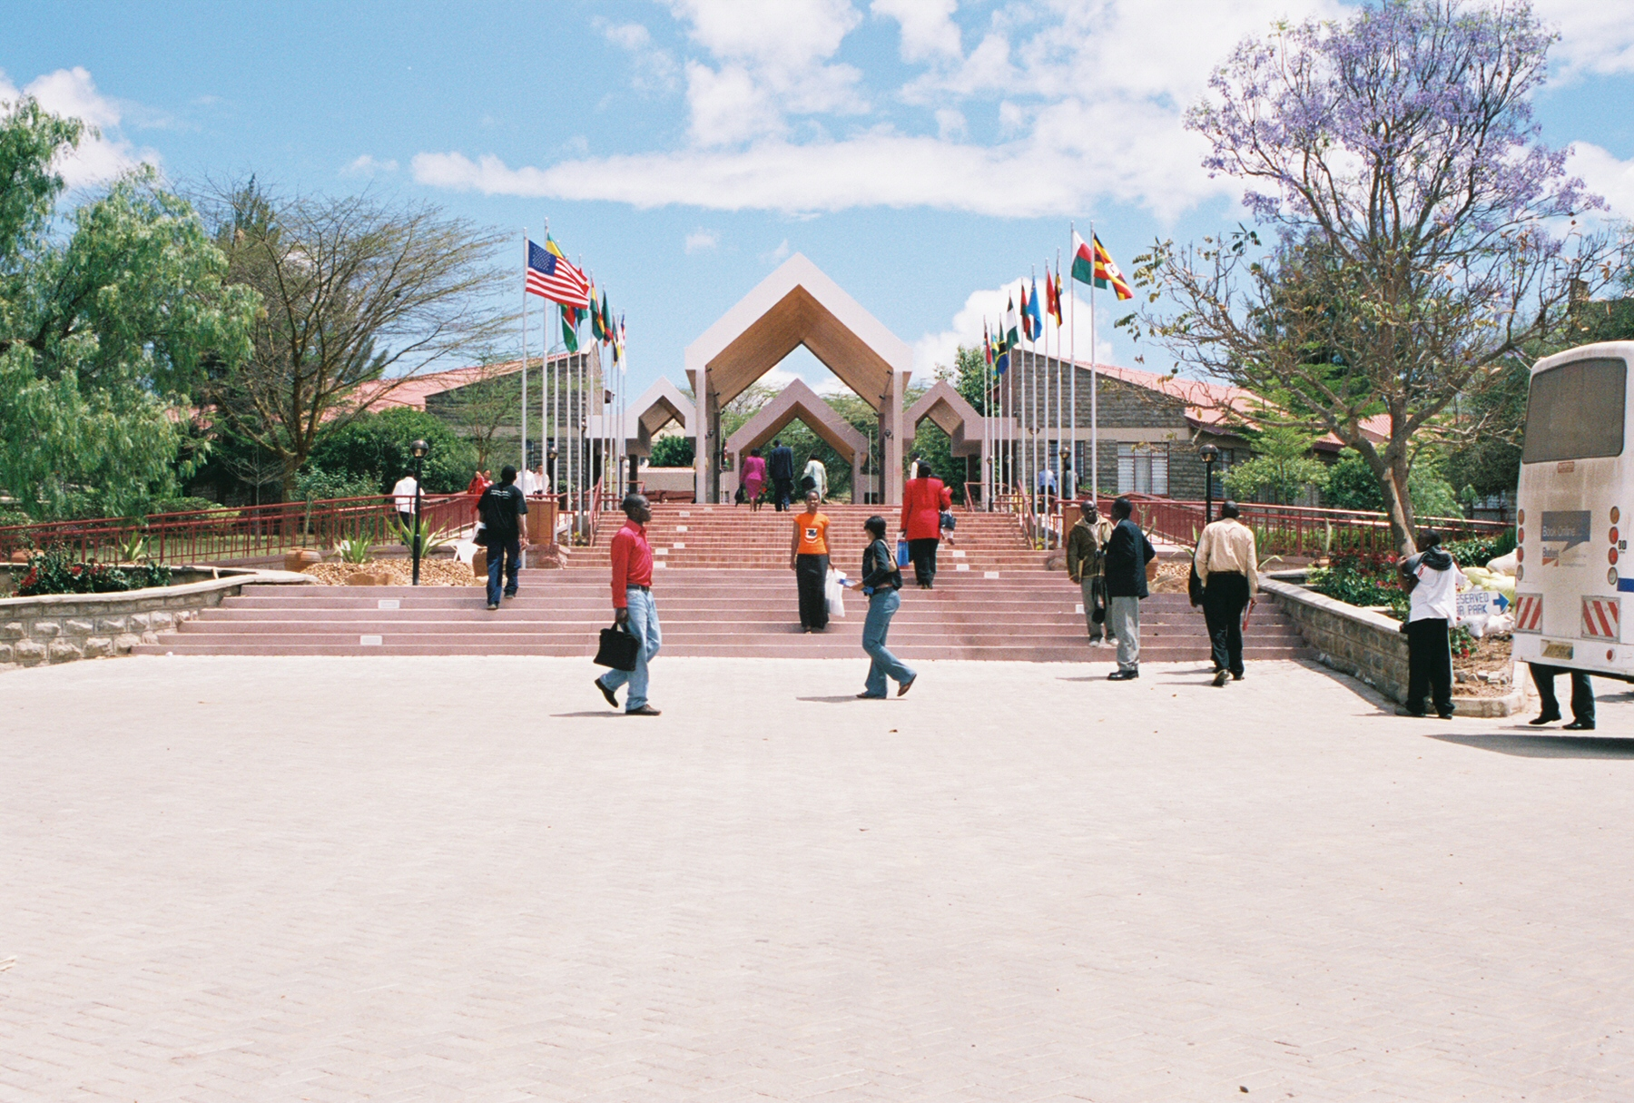
Athi River Campus
Most of the Daystar undergraduates take their classes at this campus. The student population is over 2,000 students.
The campus, which is on a 300-acre piece of land, is connected to the main Mombasa Road by a 5-kilometre all-weather murram road.

Slide 8
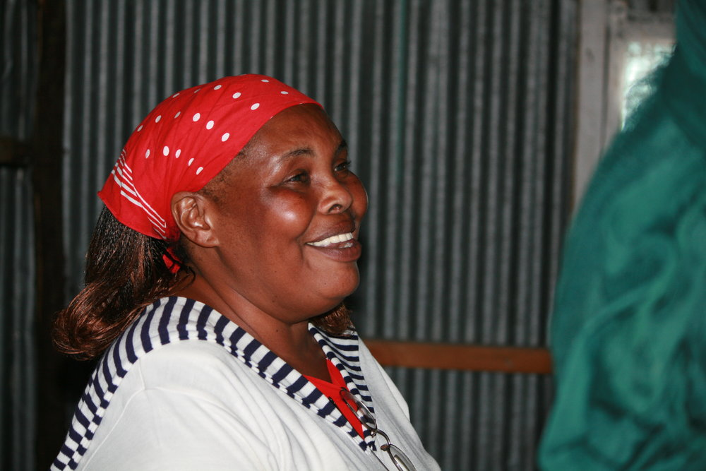
MARY MAMBO FOUNDER, CANA CHILDREN’S CENTER
Mary Mambo graduated from Daystar University in 2000 with a bachelor’s degree in counseling and psychology. Shortly after graduating she founded Cana Children’s Center, a humanitarian center located in a vast Nairobi slum. This is the only center of its kind in a slum of more than 250,000 people. The center addresses a variety of community issues including tuberculosis, preventing mother-to-child HIV transmission, and reducing infant and maternal death. Each month, approximately 170 healthy babies are born in Mary’s clinic.
The center also rescues young girls who have been sexually abused, giving them a safe place to live and go to school. Approximately 300 children and youth attend school at Cana Children’s Center. Every day Mary provides a meal for all of them. She said, “Our work is a holistic ministry; we help people spiritually, physically, and emotionally. We take the whole person and help the whole person.”

Slide 9
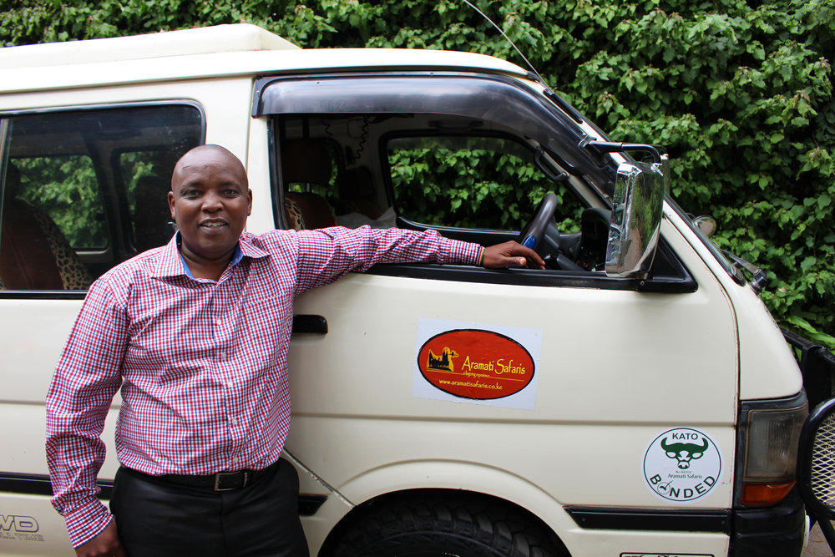
John Ndegwa studied communication and marketing at Daystar University. When he graduated in 1999, he asked himself, “How can I glorify God in what I do?” John didn’t think he had the right skills to become a pastor but knew whatever he did, he wanted to have a role in furthering God’s Kingdom.
John always had an interest in tourism and so with one van and a dream to serve, John started Aramati Safaris. He started his tourism company with the intention of accommodating pastors and missionaries in particular. “
Aramati means ‘stewardship’ in John’s native language. “It is a constant reminder that I am a steward to God’s resources, my clients, and my employees.”
John now has four vans and four drivers. He is good to his employees, paying them fair wages and even giving them opportunities to buy the vans they drive, so they can have a stake in the company. Aramati Safaris has proved itself to be a reliable company, earning the Kenya Association of Tour Operators (KATO) bonded rating.
JOHN NDEGWA
OWNER, ARAMATI SAFARIS

Slide 10
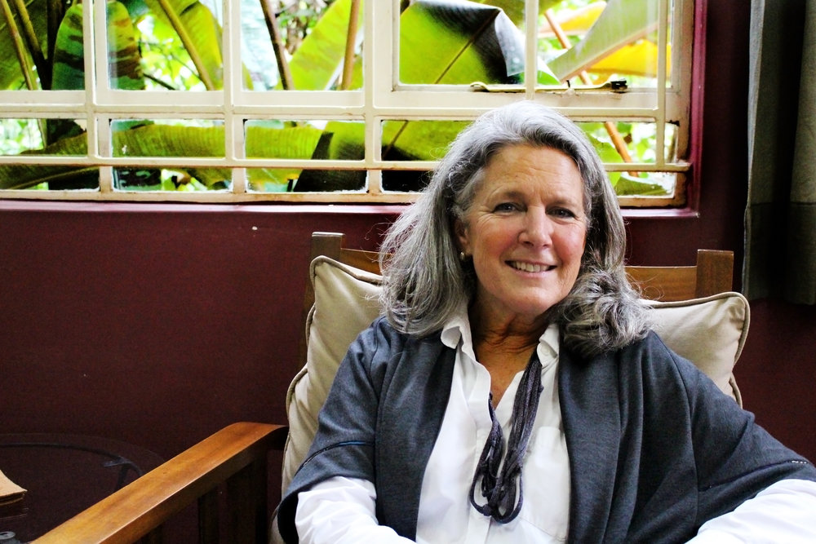
Becky Chinchen isn’t your typical Daystar Alumni. In fact, she didn’t graduate from Daystar at all. But Daystar University played an integral role in the birth of Amani ya Juu, a social enterprise that touches the lives of thousands of refugee women.
Becky, her husband, and their four daughters were missionaries in Liberia when civil war broke out. They were forced to flee, becoming refugees themselves. They relocated to Kenya in hopes to start their ministry there.
Becky enrolled in three master’s level classes at Daystar University in order to learn more about their new home and country. One of the classes she took was Community Development and the Church. Becky said, “We had an assignment to create our own community development project and I found myself at a loss because I didn’t do healthcare or agriculture or water.” all in need of healing.”
So she decided to focus on what came naturally to her: textiles + refugees, with a focus on peace and reconciliation. “Because really, it doesn’t matter if we’re refugees or not, we all have this brokenness. We live in a broken world and we’re all in need of healing.”
After turning in her paper and completing the course, Becky had no intention of implementing her project.
But when she heard of some refugee women in need of work, she decided to put her project into action. With a personal loan of $500, the women began making place mats in Becky’s home in Nairobi and selling them at hotels, events, and local shops. Through the blend of ministry and business Amani ya Juu emerged as a holistic economic enterprise.
““Learning from an African professor at Daystar University was a huge part of the success of Amani.”
“And the rest is history,” Becky said. Amani ya Juu, meaning ‘peace from above’, provides a safe community for refugee women where they can heal from the wounds of their past, learn valuable skills, and make lasting friendships.
"Learning from an African professor at Daystar University was a huge part of the success of Amani," Becky said.
The seeds of peace that were first sown in the Nairobi center have continued to spread and multiply. As women returned to their home countries or repatriated to new homelands, they take Amani with them. A presence of peace has been established in numerous cities, countries and communities, wherever women with a vision of peace have gone –Kakuma Refugee Camp, Rwanda, Maasailand, Burundi, Somali Eastleigh, Mathare slums, Gulu Uganda, Liberia, Washington DC, Chattanooga and more.
Becky Chinchen isn’t your typical Daystar Alumni. In fact, she didn’t graduate from Daystar at all. But Daystar University played an integral role in the birth of Amani ya Juu, a social enterprise that touches the lives of thousands of refugee women.
Becky, her husband, and their four daughters were missionaries in Liberia when civil war broke out. They were forced to flee, becoming refugees themselves. They relocated to Kenya in hopes to start their ministry there.
Becky enrolled in three master’s level classes at Daystar University in order to learn more about their new home and country. One of the classes she took was Community Development and the Church. Becky said, “We had an assignment to create our own community development project and I found myself at a loss because I didn’t do healthcare or agriculture or water.” all in need of healing.”
So she decided to focus on what came naturally to her: textiles + refugees, with a focus on peace and reconciliation. “Because really, it doesn’t matter if we’re refugees or not, we all have this brokenness. We live in a broken world and we’re all in need of healing.”
After turning in her paper and completing the course, Becky had no intention of implementing her project.
But when she heard of some refugee women in need of work, she decided to put her project into action. With a personal loan of $500, the women began making place mats in Becky’s home in Nairobi and selling them at hotels, events, and local shops. Through the blend of ministry and business Amani ya Juu emerged as a holistic economic enterprise.
““Learning from an African professor at Daystar University was a huge part of the success of Amani.”
“And the rest is history,” Becky said. Amani ya Juu, meaning ‘peace from above’, provides a safe community for refugee women where they can heal from the wounds of their past, learn valuable skills, and make lasting friendships.
"Learning from an African professor at Daystar University was a huge part of the success of Amani," Becky said.
The seeds of peace that were first sown in the Nairobi center have continued to spread and multiply. As women returned to their home countries or repatriated to new homelands, they take Amani with them. A presence of peace has been established in numerous cities, countries and communities, wherever women with a vision of peace have gone –Kakuma Refugee Camp, Rwanda, Maasailand, Burundi, Somali Eastleigh, Mathare slums, Gulu Uganda, Liberia, Washington DC, Chattanooga and more.
BECKY CHINCHEN FOUNDER, AMANI YA JUU

Slide 11
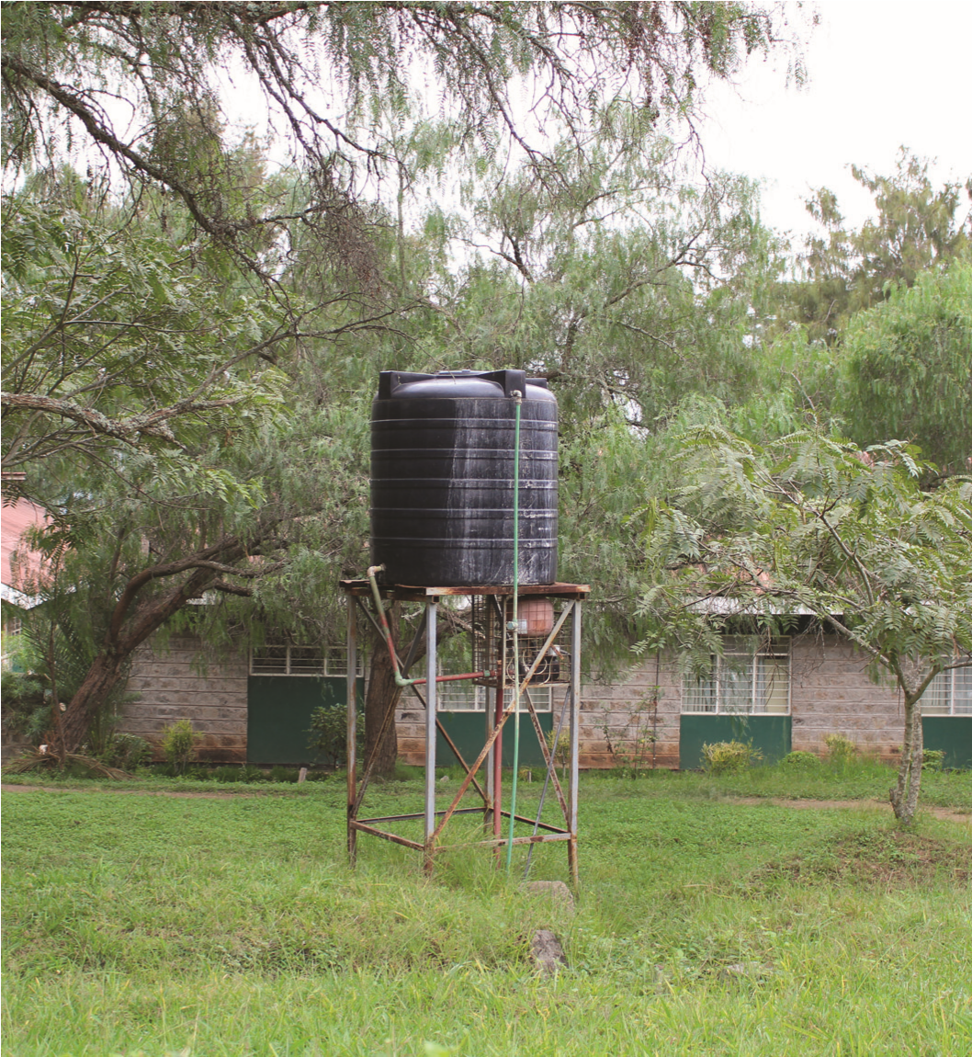
DAYSTAR U.S. WATER PROJECT
The University’s vision is to double the current student enrollment and expand its programs to eventually include a law school, an engineering school, a medical school, and a 120 bed teaching hospital which would serve the surrounding community. There is currently no hospital in this area.
As with any growing university, there is a community springing up around it comprised of homes, merchants, food vendors, internet cafes, clothing shops, and schools. This water project will not only benefit the University but will also benefit the 2,000 neighbors in a community which continues to grow with no reliable water supply.

Slide 12
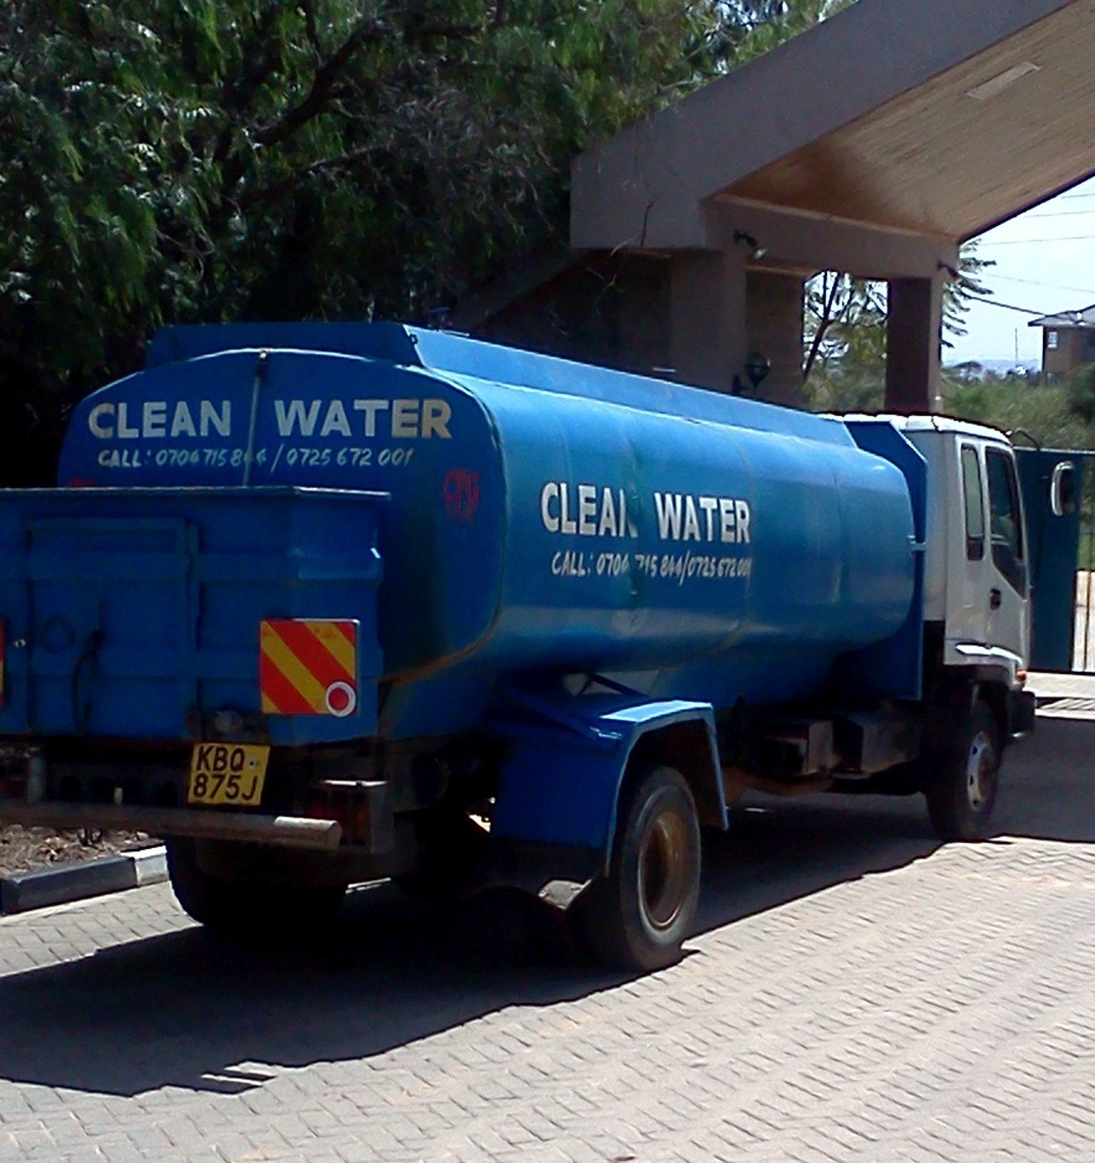
Daystar’s Water Project will:
• Allow the student body to grow and add more dormitories and classroom facilities.
• Build new housing for faculty and staff.
• Expand the campus to include primary and secondary schools.
• Develop plans for a teaching hospital serving the surrounding community.
• Provide clean, reliable water for not only Daystar, but also the community surrounding the campus.
• Improve the health of children living in the area by targeting common water-borne and nutrition illness.

Slide 13
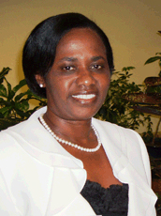
Professor Mary Murimi - Chancellor, Daystar University
PhD. RD Professor of Nutrition Texas Tech University College of Human Sciences
Education and Professional background
Graduated with a Ph.D. in Human Nutrition with an emphasis in community nutrition and behavior change from Iowa State University in August 1996.
Registered Dietitian with the American Dietetic Association since 1993
Member of the Society of Nutrition Education since 1992
1992 M.S. Eastern Illinois University, Food and Nutrition/Dietetics
1990 B.S. Mundelein College, Food and Nutrition/Dietetics
Experience
She started her teaching and research career at Louisiana Tech University in 1998 where she progressed through all the academic ranks, took a sabbatical at Yale in 2008, and Joined Texas Tech in 2012.
She is currently a full professor of Nutrition at Texas Tech University in the department of Nutritional Sciences engaged in teaching, grant writing, and research at the local and international level. Leadership responsibilities are part of the package.
She has been a member of the Board of directors for the Society for Nutrition Education for the last 5 years from 2011 to current and now assuming full presidency in 2016.
She is the President-Elect and the chair of the 2016 annual conference for the Society of Nutrition Education and Behavior.

Slide 14
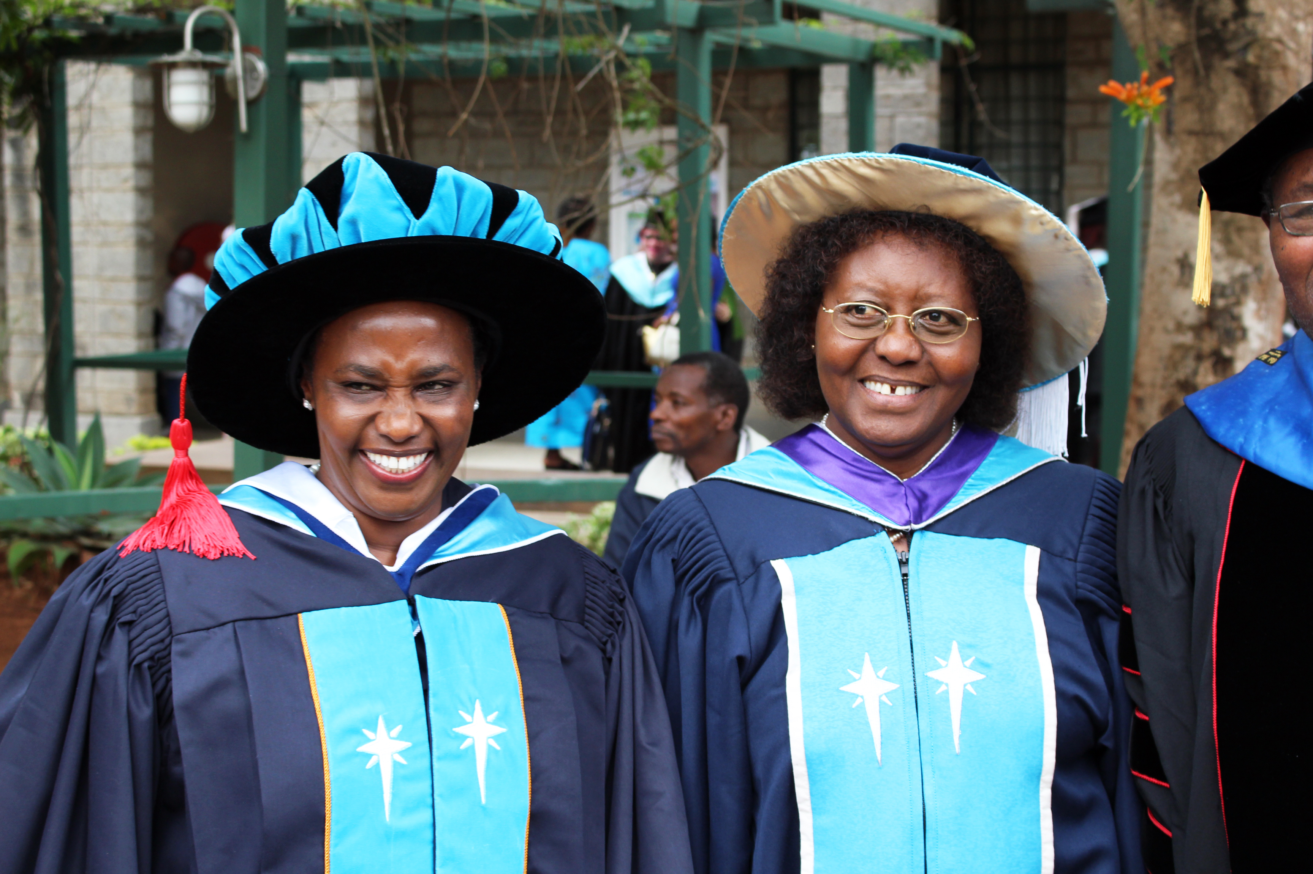
At her community research laboratory, she is mentoring a total of 5 doctoral students from Kenya, Eritrea, Bangladesh, Vietnam, and Saudi Arabia and a post-doc fellow from Kenya. At the community level, she is the lead nutrition researcher for the East Lubbock Promise neighborhood and a member of the International Center for Food Industry Excellence cluster at Texas Tech University.
She has made international memorandum of understanding between Texas Tech University and Kenyatta University, The Kenya Medical Research Institute, The Vaal University of Technology in South Africa, Rwanda college of Public Health, The Jigjiga University in Ethiopia
Research and Publications
Prof. Murimi is widely published with more than 35 works published.
She has served the Journal of Nutrition Education and Behavior as an Associate Editor since 2008 to current, determining the articles that are timely and educational, and guiding both reviewers and authors in the production of timely, accurate, and relevant articles.
Professor Murimi with Daystar’s former Chancellor Dr. Florence Muli-Musiime, who was the first female university chancellor in all of Africa.

